Slide 1

Cyclistic Bike-Share Bike Analysis
Brent Lund, Data Analyst | Portfolio Project

Slide 2
Project Summary
In this case study, I analyzed how casual riders and annual members use Cyclistic bikes differently, using trip data from Q1 2019 and Q1 2020. I used R to clean and process the data and Tableau to visualize patterns in ride duration and frequency. The findings support targeted marketing strategies to help convert casual riders into members. This project was completed as part of the Google Data Analytics Capstone.

Slide 3
How do annual members and casual riders use Cyclistic bikes differently?
Deliverable:
Determine how annual members and casual riders use Cyclistic bikes differently in order to provide actionable insights that can inform a marketing strategy aimed at converting more casual riders into annual members.
What was reviewed:
Trip length for members vs casual riders
Number of Riders under each category

Slide 4
Data Sources
Divvy trip data, 2019 Q1 + 2020 Q1 .csv files
Data cleaned, processed, and analyzed in R studio
Visually produced in Tableau

Slide 5
Data Cleaning and Preparations
Columns renamed to match between files
Convert/mutate characters for correct stacking
Stack files into one big data frame

Slide 6
Identify Problems in Data
Added day, month, year for grouping
Removed quality-control outliers
Add a calculated field for trip length
"member_casual" column, replace "Subscriber" with "member" and "Customer" with "casual"
Ride-level too granular
Deleted data where duration was negative or QC rides made by company

Slide 7
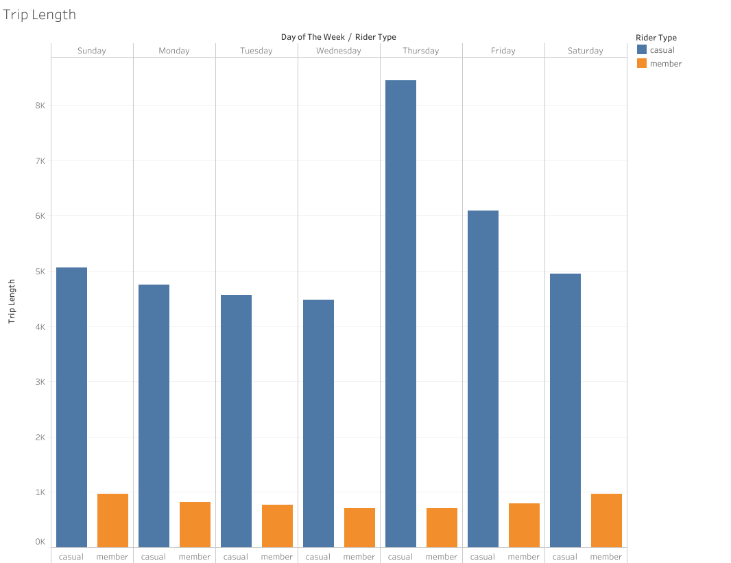
Casual Riders, Ride Longer
Casual riders travel further distances
Members ride for commuting

Slide 8
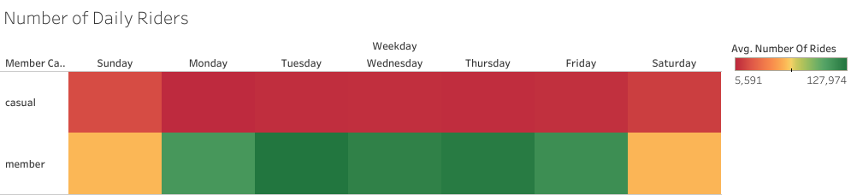
Rider Duration Patterns by Day and Rider Type
Increased casual riders on weekends
Increased member riders on weekdays

Slide 9
Key Behavioral Differences Between Members and Casuals
Casual riders take longer rides, especially on weekdays.
Members ride more consistently–likely commuting.
Casual riders peak on weekends, Members peak during week.

Slide 10
Goal: Convert Casual riders into Members
Offer weekend discounts to help convert casual riders to members
Members are commuting, so market the savings casual riders will have if they switched to Members. Member cost vs fuel consumption.
Use targeted digital ads for casual users who ride frequently. In high tourist areas or areas where casual riders are starting/ending rides.

Slide 11
Thank you
This project was completed as part of the Google Data Analytics Capstone
Tools used: Excel, R, Tableau, Google Slides
Brent Lund
brentnlund@gmail.com

